Slide 1
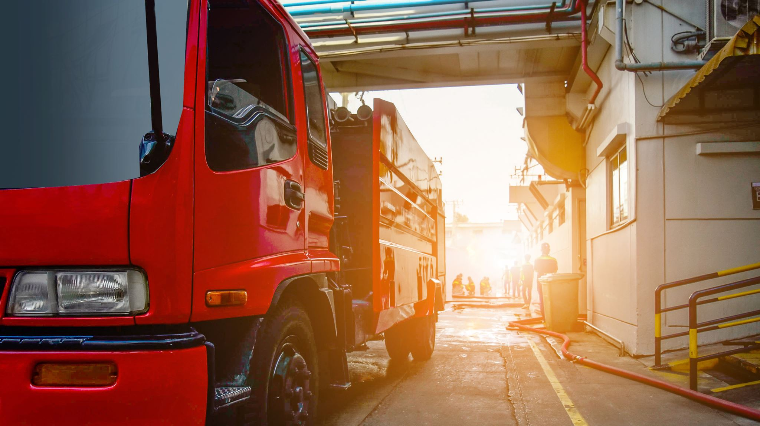
Emergency Action Planning: Preparing for the Unexpected
Outside the Lines – “The Perimeter Game”

Slide 2

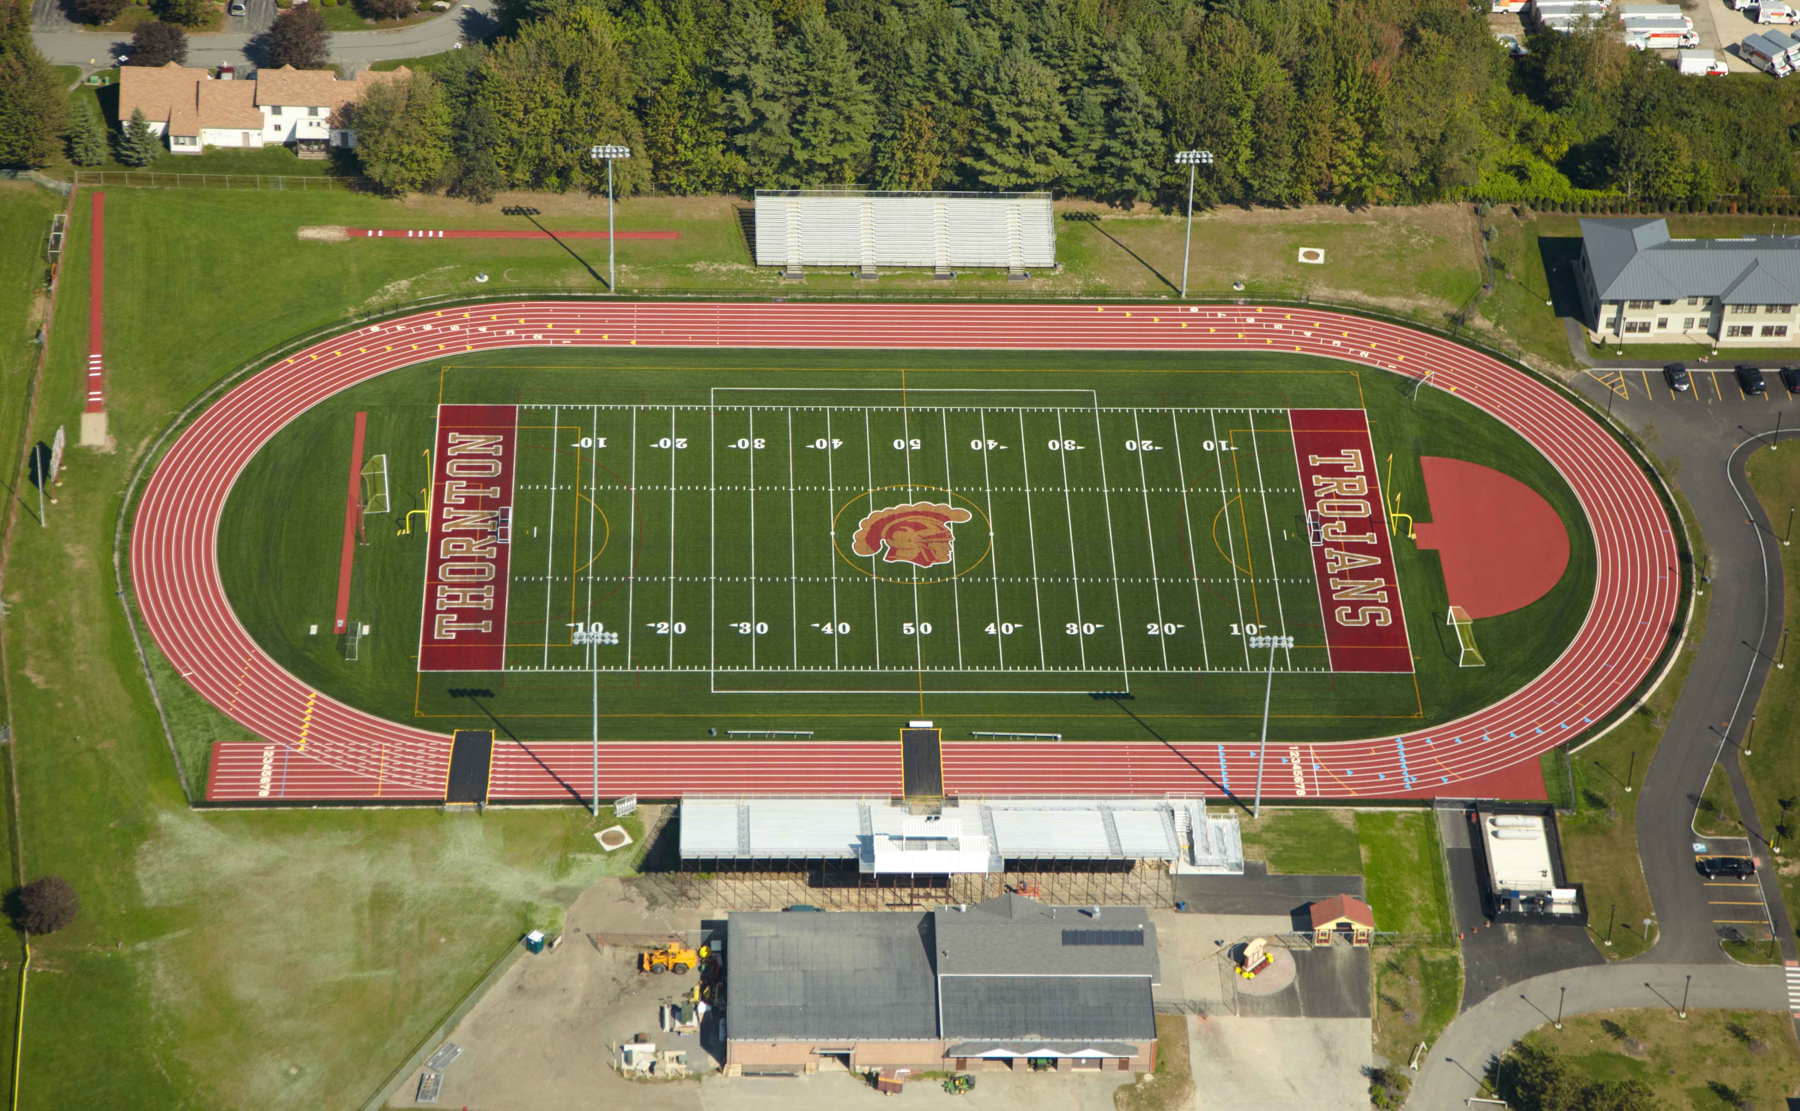

Slide 3



Safety, Security, and Emergency Planning Beyond the Game or Venue Itself

Slide 4
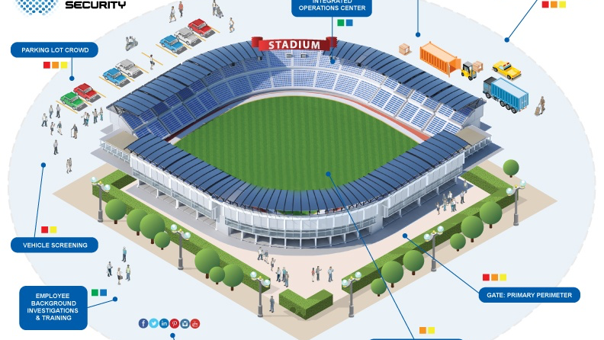
Focus: The Perimeter

Slide 5
What is the perimeter that you are responsible for?

Slide 6
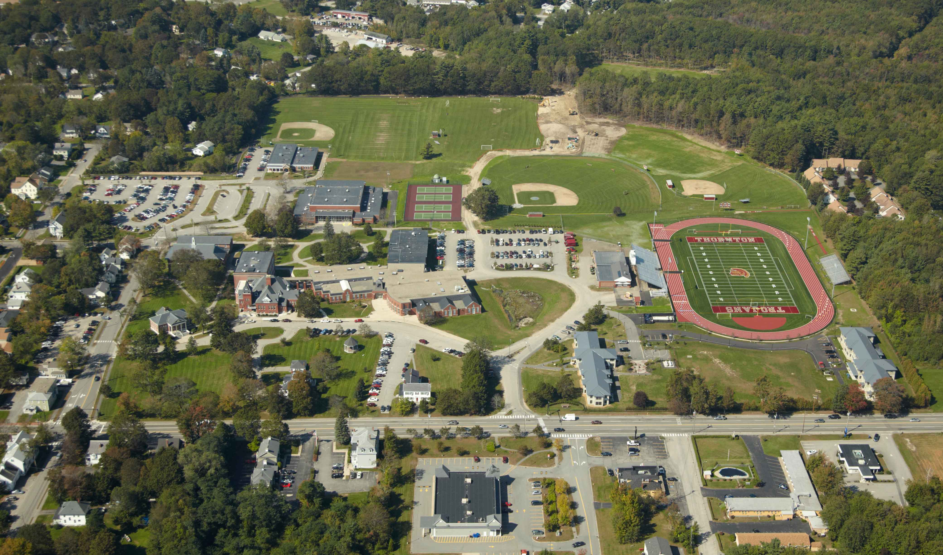

Slide 7
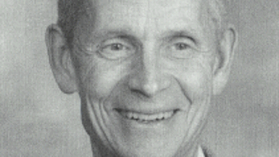
Dr. John Olson, CMAA

Slide 8

Dr. John Olson, CMAA
“You are considered to be the content expert in your field and have a legal responsibility.”
“If you could have known, you should have known.”

Slide 9
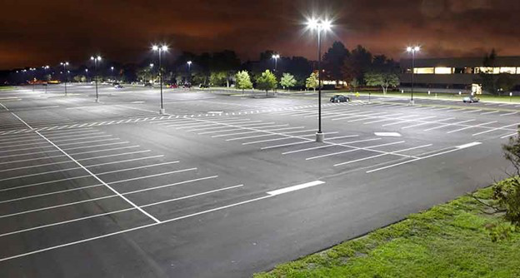
Parking Lot Safety and Security
Clearly lined and defined spaces
Numbered parking spaces
Designation of Areas (similar to airport parking garages)
Well-lit (LED lighting)

Slide 10
Parking Lot Safety and Security
Do you know what is going on in the parking lot areas during your activities?
Personnel presence/check-ins

Slide 11
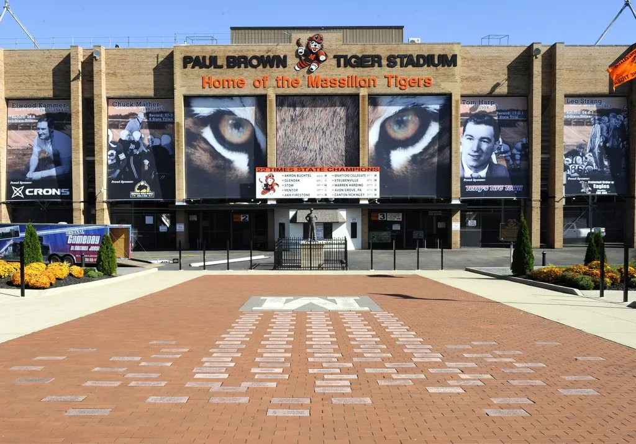
Entrance and Egress Points
Signage as necessary
  Prohibitive Behaviors
Intuitive flow of traffic
Supervisory Personnel
Communication Systems

Slide 12
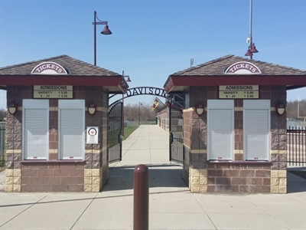
Safety and Security in Ticketing Areas
Where the money is
Soft target for theft or violence
Need for proper lighting
Need for security presence
Frequent “check-ins”

Slide 13
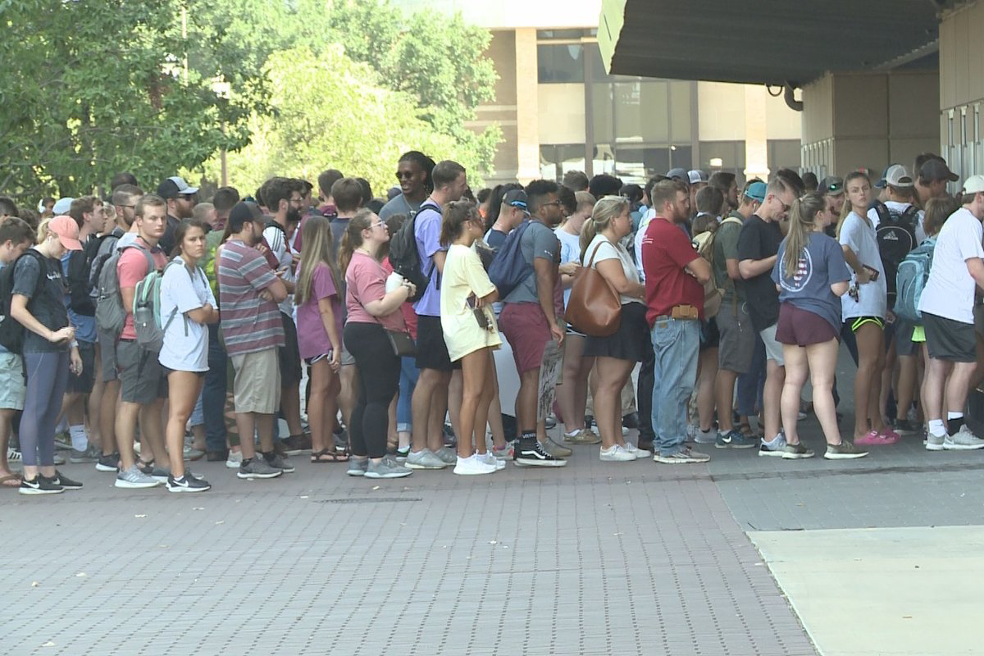
Managing Throughput
Clearly defined lines into the venue
Screening Protocols – may be site-specific
CPTED (Crime Prevention Through Environmental Design)
See and be seen

Slide 14
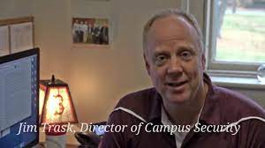
Your “Eyes” at an Athletic Event
Parking Attendants
Box Office Personnel
Director of Security
Police Officers
Concessionaires
Cameras – “artificial eyes”
  Mounted
  Affixed to personnel

Slide 15
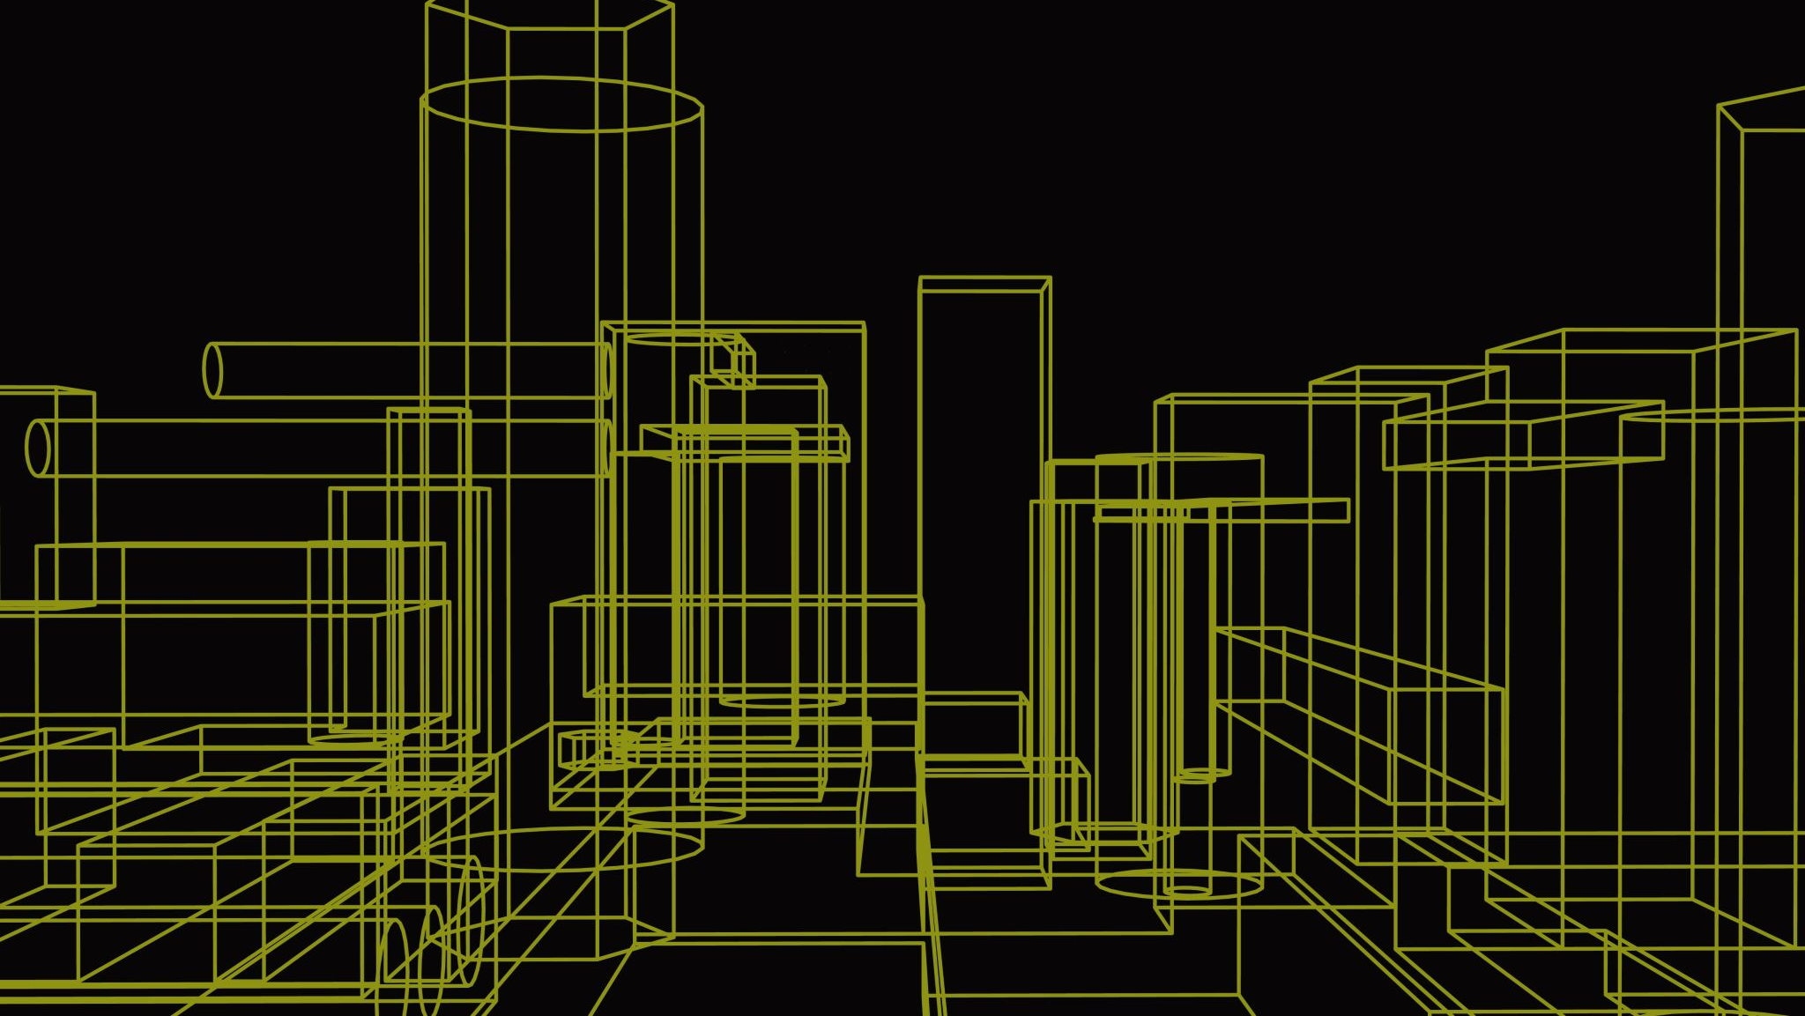
The Need for Planning

Slide 16
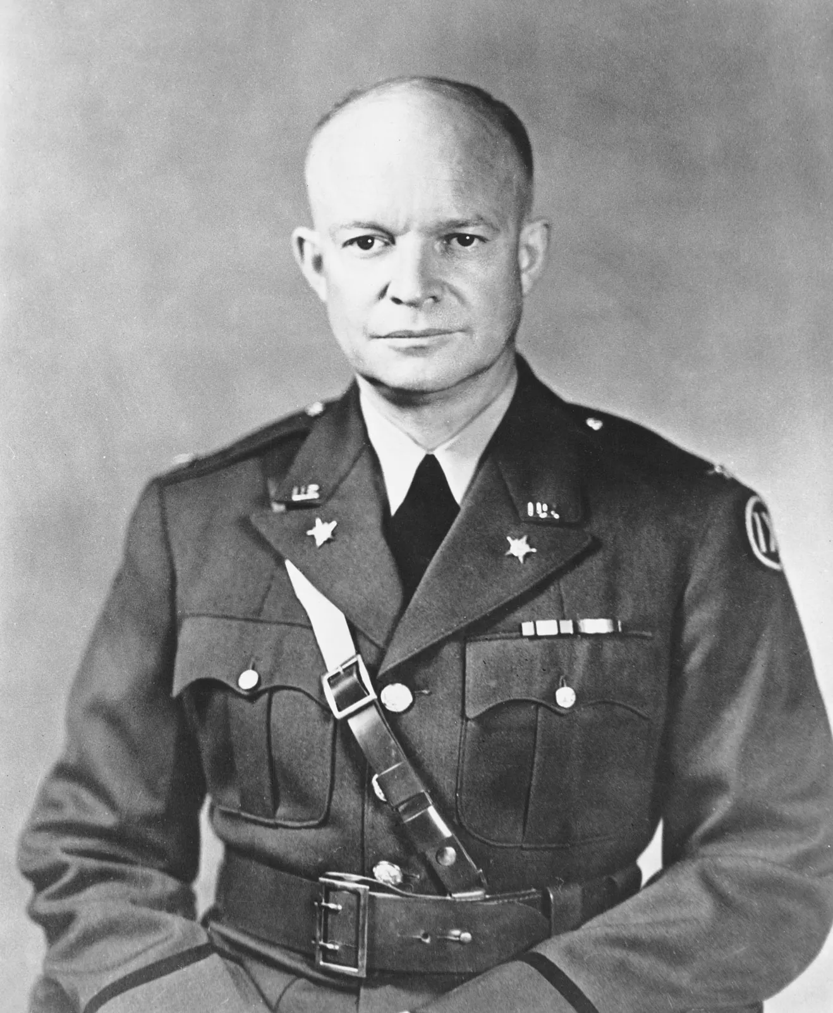
Dwight Eisenhower on Planning
“In preparing for battle, I have found that plans are worthless, but planning is everything.”

Slide 17
Dwight Eisenhower on Planning
“…the very definition of 'emergency' is that it is unexpected, therefore it is not going to happen the way you are planning.”

Slide 18

Expect the Unexpected

Slide 19
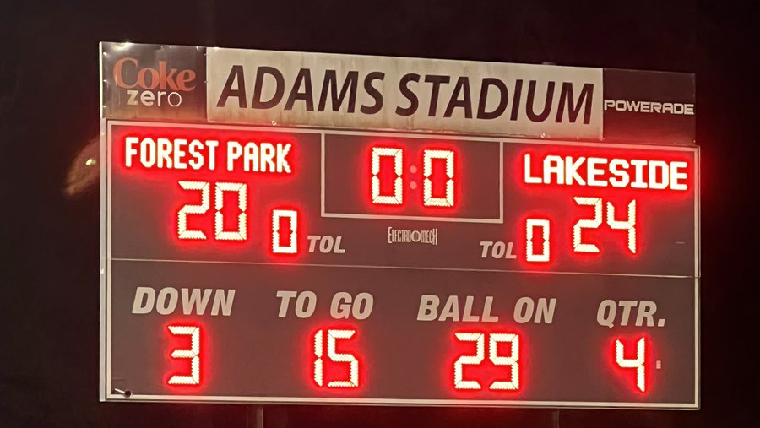
The game is over . . . Or is it?

Slide 20
What happened during the game?

Slide 21
What could occur after the game?

Slide 22
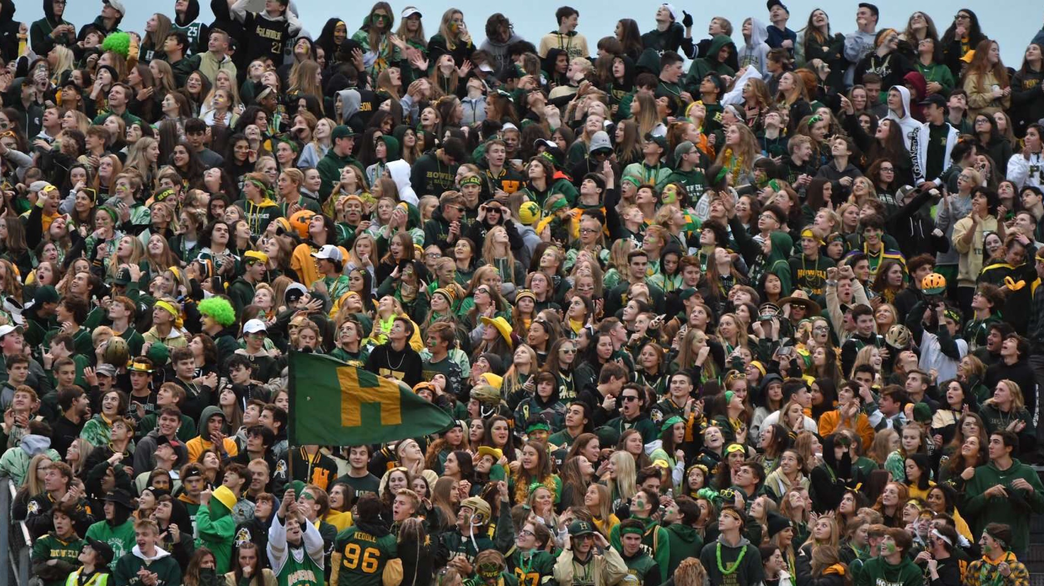
Postgame: Areas for Concern
There may be clues that problems exist that may drift out to the perimeter!!!!
Anger in the crowd
An angry or animated coach
The “controversial call”
Student sections
  Behavior of Individuals
  Group chanting that goes awry

Slide 23
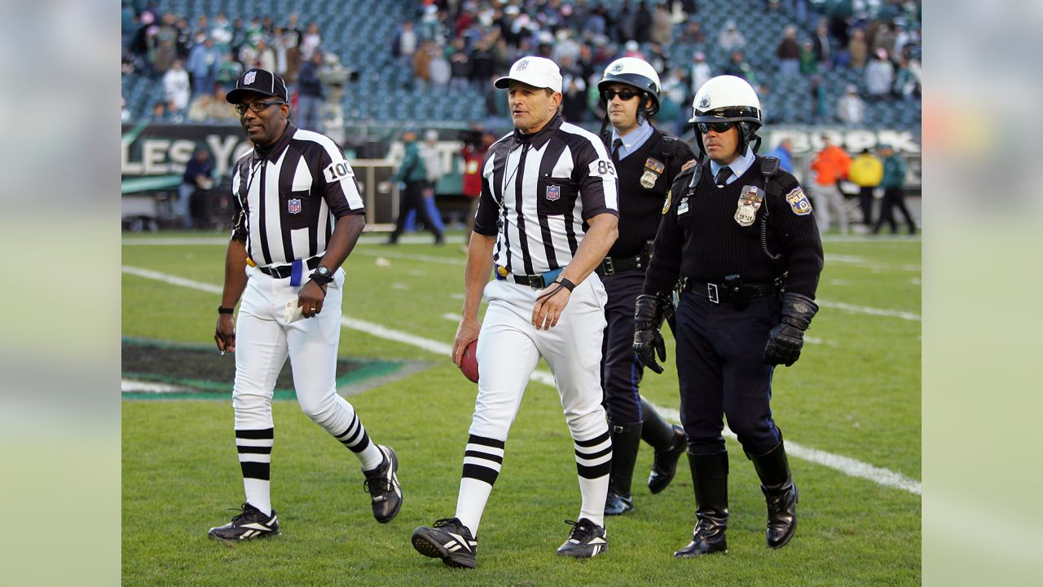
Addressing Officials Safety
Having an “Escape Hatch”
Plan B
Case Study: New Hampshire Lacrosse Officials
The need for a safe escort

Slide 25
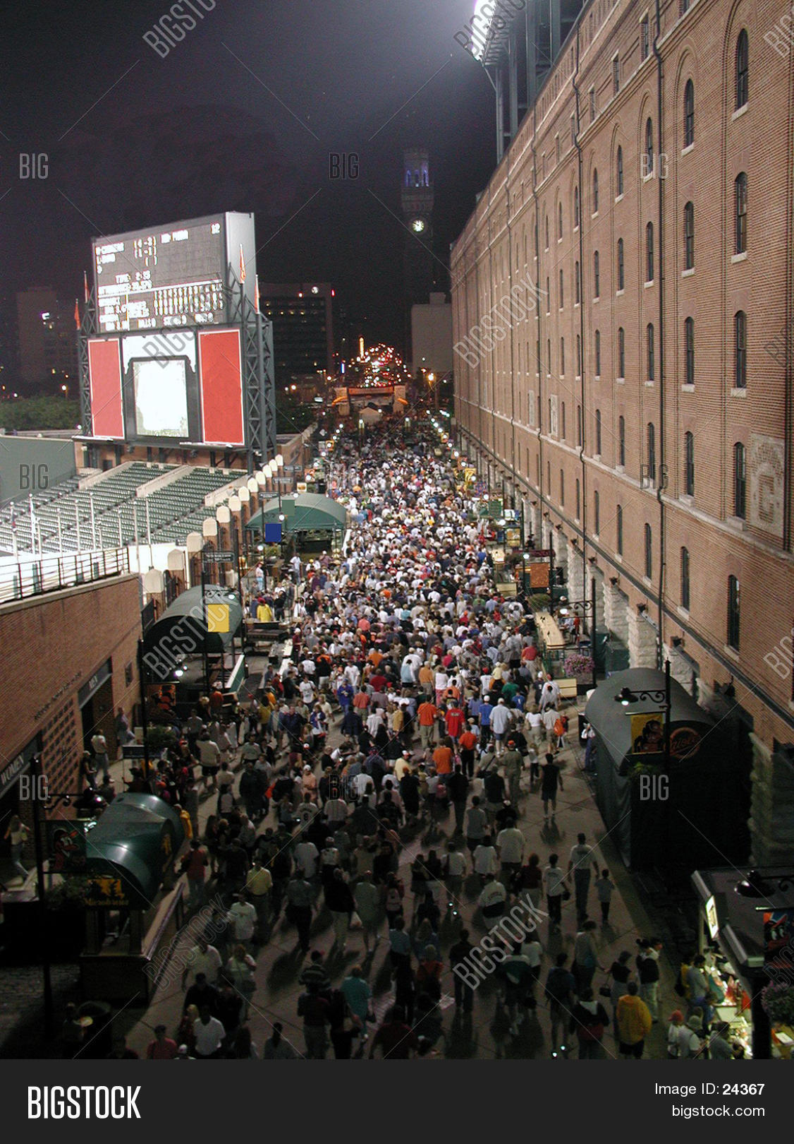
Egress Patterns
Home Team
Visiting Team
Spectators
  Multiple Egress Points
Eyes on the queue
Support

Slide 26

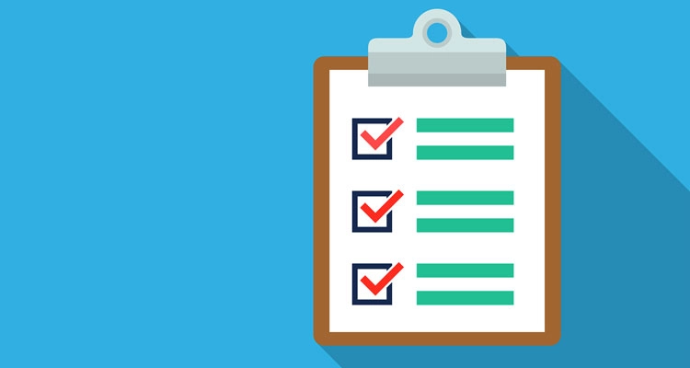

Resources for Managing the Perimeter
Additional Personnel
  School
  Parking Staff
  Security/Police
  EMS
  Athletic Trainers on call

Slide 27
Resources for Managing the Perimeter
Know the talents of those assisting you
Skill Set Inventory
  CPR/AED
  First Aid Training
  Languages (including ASL)
  Registered Nurses
  Hazardous Materials Training
  CDL

Slide 28
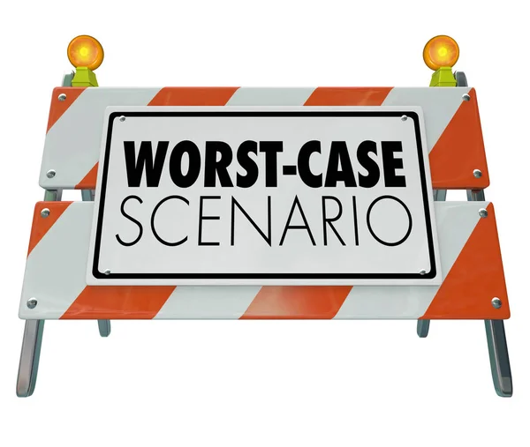
Planning for the WCS (Worst Case Scenario)
What are the worst case scenarios that you can imagine?
How vulnerable is your school campus or athletic venue?
What will be your response?
Expect the unexpected

Slide 29

Table Top Exercises
Develop likely and unlikely, yet possible, scenarios
Assemble your team
Document:
  Who was present
  Conclusions reached
  Date
Revisit scenarios as necessary

Slide 30
Scenarios to Consider in the 21st Century
Active Shooter
Explosion
Major Fight
Automobile Accident on the Property or Nearby
Chemical Spills
Major Medical Incident
  Maine scenario – Fall, 2022

Slide 31

Caden and His Bicycle

Slide 32
Resource for Table Top Exercises
Idaho state government website
https://schoolsafety.idaho.gov/ten-minute-tabletop/

Slide 33
Need for Training
Event Staff Meetings – make them meaningful and interactive
Bring in Experts to talk with your team – Members of local police and EMS
Use of visuals – maps/photographs
  Numbered areas
  Display

Slide 34
Need for Practice
“Walk Throughs”
Zac Stevenson – “Radio Call” Rehearsals
  Pregame – Before fans arrive
  Pregame – After fans arrive
  During the Game

Slide 35
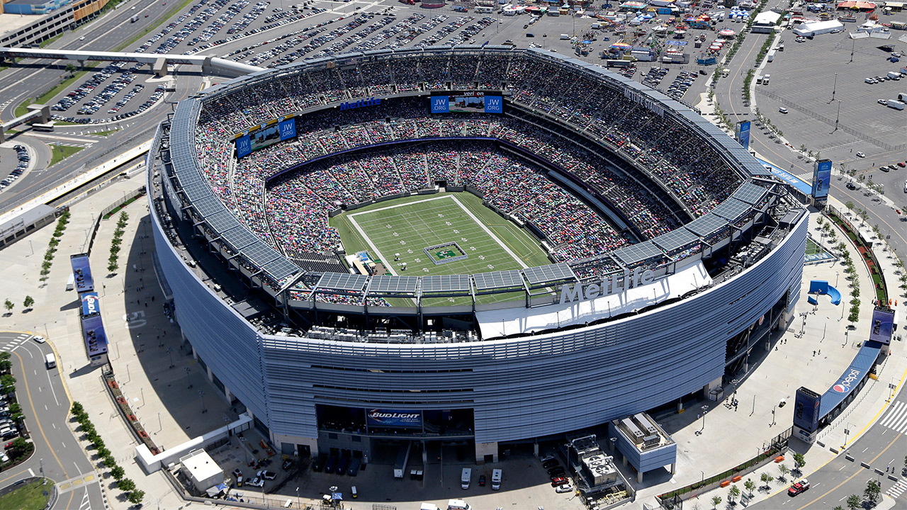
MetLife Stadium – The Meadowlands, New Jersey

Slide 36
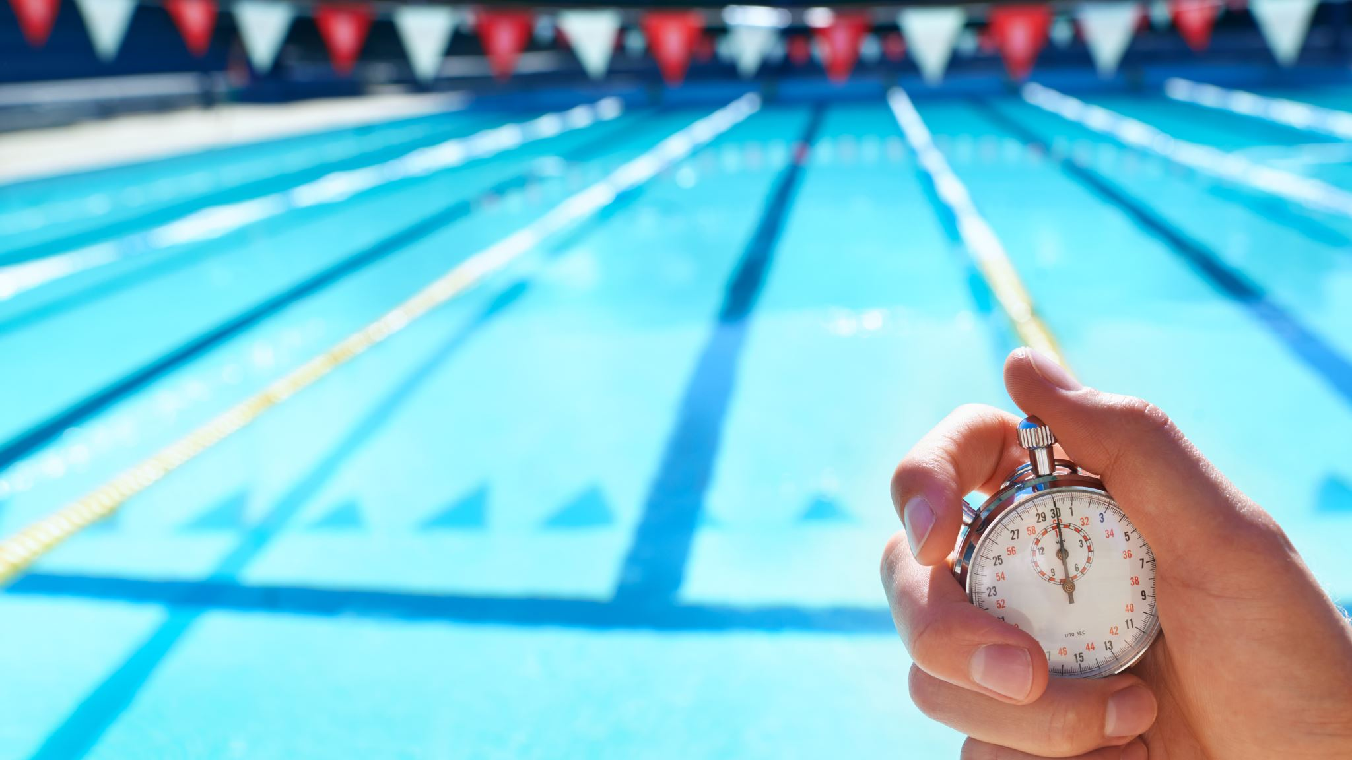
The Perimeter: Other Questions to Consider
How are you managing threats to safety communicated on social media?
Practices taking place on secondary venues
Games taking place at off-campus facilities (ex. golf, swimming, subvarsity)
Non-Athletic Activities – What measures are in place to support the supervisors and participants?
  Band rehearsal
  Play practice
“Swatting” – How might that impact your athletic program?

Slide 37
Contact Information
Gary Stevens, CMAA
Thornton Academy – Saco, Maine
gary.stevens@thorntonacademy.org
gstevens@sjcme.edu
Office: (207)-602-4406
Cell: (207)-671-4578

Slide 38

Thank you for attending!!!

