Slide 1


The National Epidemic of Adolescent and High School Student Mental Health:
The Effect on Athletes, Coaches and Administrators
JAMES R. BORCHERS MD, MPH
U.S. Council for Athletes’ Health

Slide 2
Key Considerations
Student athlete concerns
Generation Z
Best practices for student athlete, coach, and AT - mental health education
Mental health Emergency Action Plan (EAP)
Finding mental health/wellness resources

Slide 3

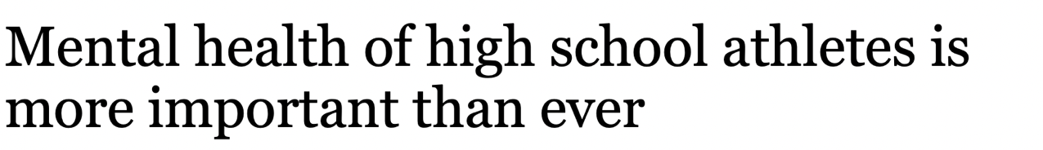
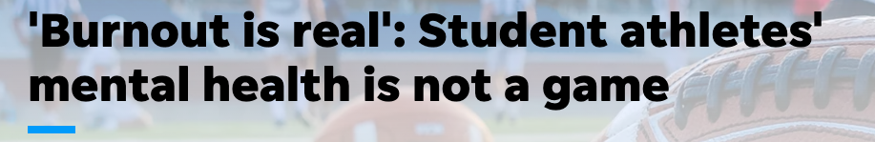



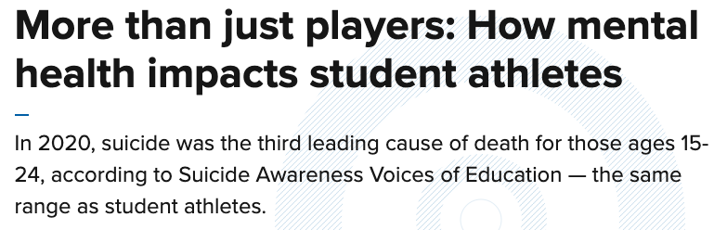
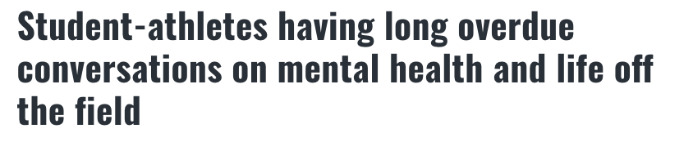



Student Athlete Concerns

Slide 4

Who is Gen Z?
Born between late 1990’s and early 2010’s
First 100% digitally native generation
More comfortable with tech skills than “soft” skills
50% of Gen Z is non-white

Slide 5
Gen Z Characteristics
Compared to previous generations - decreased rates of
  Drinking
  Drug and alcohol use
  Dating/sex
  Overall, less risky behavior
Delays in work and obtaining driver license
  Delayed maturity/adulthood
Time with friends, but alone
  Use of technology to communicate
  Less in person interactions

Slide 6
Gen Z – Contributors to Anxiety
More time on-line
“Virtual friends”
FOMO
Huge emphasis on academic and/or athletic success
Life is scheduled from “awake to asleep”

Slide 7
Gen Z
Gen Zer's, ranging from middle school students to early professionals, are reporting higher rates of anxiety, depression, and distress than any other age group
Gen Zer's were more likely (1.8x) to report having a behavioral-health diagnosis but less likely to seek treatment compared with other generations
Factors that account for Gen Z’s lack of seeking help: developmental stage, disengagement from their healthcare, perceived affordability, and stigma associated with mental disorders

Slide 8
Gen Z
When they do seek support for behavioral-health issues, Gen Z may not be turning to regular outpatient mental-health services and instead may rely on emergency care, social media, and digital tools
Many Gen Zer's also indicated their first step in managing behavioral-health challenges was going to TikTok or Reddit for advice from other young people, following therapists on Instagram, or downloading relevant apps
Gen Z values diversity when choosing a healthcare provider

Slide 9
Gen Z Athletes
Many student-athletes report higher levels of negative emotional states than non-student-athlete adolescents
High-school sports have begun to copy the training methods and intensity levels of college sports - “sports professionalization”
“Intensive parenting” has become the norm, parents in recent decades have pressed upon their kids the idea that endless practice is the route to athletic mastery
Youth sports industrial complex

Slide 10
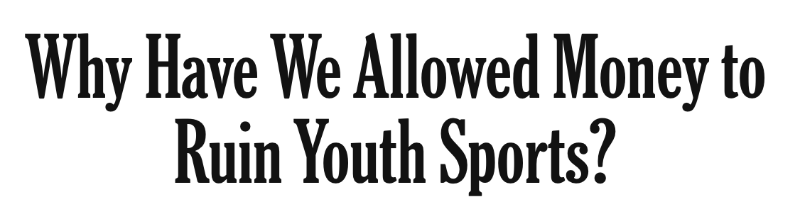
Gen Z Athletes
Study from Utah State: the more money parents spend on their child’s sports (training, travel, tournaments), the less the child enjoys it and the more pressure they feel; more likely to exhibit burnout and suffer from mental health issues

Slide 11
Gen Z: Areas to Explore
Emerging role of digital and telehealth – virtual healthcare platforms and resources
Need for stronger community-based response to behavioral-health crises
Better meeting the needs of Gen Z where they live, work, and go to school
Promoting mental-health and wellness literacy
Investing in behavioral health at parity with physical health
Supporting a holistic approach that embraces behavioral, physical, and social aspects of health
Notes:
Engagement: meetings, conference events, expected attendance

Slide 12
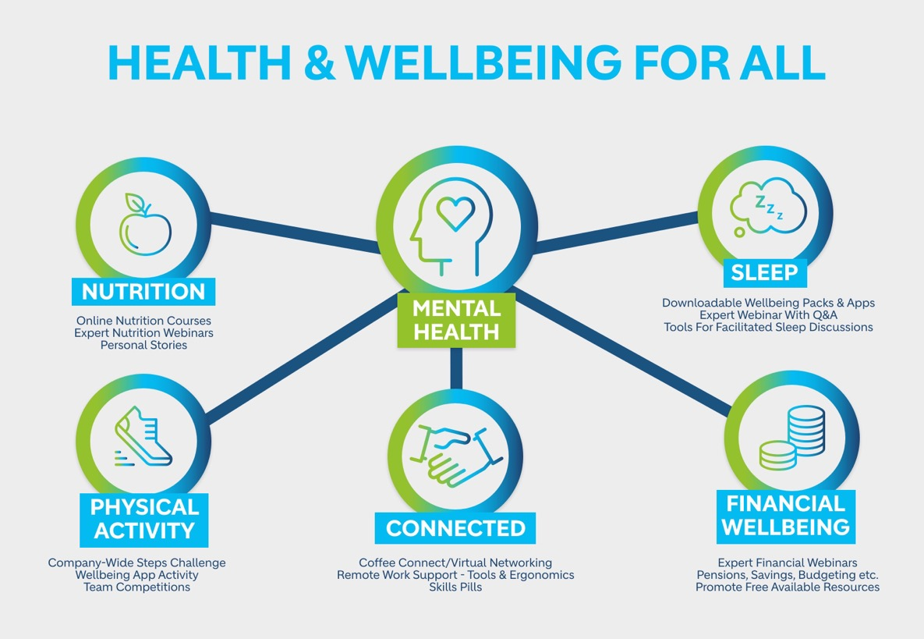
Holistic Approach
Notes:
Engagement: meetings, conference events, expected attendance

Slide 13
Mental Wellness
Mental “wellness” is more than the absence of mental illness
“A state of well-being in which the individual realizes his or her own abilities, can cope with the normal stresses of life, can work productively and fruitfully, and is able to make a contribution to his or her community.” [World Health Organization]
Schools/Athletic departments must strive to create a
culture of mental wellness
Notes:
Engagement: meetings, conference events, expected attendance

Slide 14
Culture of Mental Wellness
The school/department’s culture around mental wellness is what reduces stigma and empowers athletes to access mental health and wellness resources
Athletic Administrators and Coaches create the culture
Must create an inclusive environment
All personnel need proper training/education and support
Remove obstacles for obtaining care
Notes:
Engagement: meetings, conference events, expected attendance

Slide 15

Decreasing Stigma
Athletic Administrators and Coaches MUST:
  Support mental wellness education
  Avoid negative words around mental health
    Crazy, nuts, psycho, etc.
    Use “people first” communication
  Emphasize appropriate sleep/rest
  Provide safe space to talk about mental health
    Question, Persuade, Refer “QPR”
  Acknowledge that stigma may exist
  Stress the importance of seeking help
Notes:
Engagement: meetings, conference events, expected attendance

Slide 16

Decreasing Stigma
Coaches MUST:
  Be intentional to empower student-athletes to take control of their mental wellness by practicing good self care
  Self care requires a partnership between the coach and student-athlete with open dialogue
  Coaches are the most important influence for athletes’ mental wellness
Notes:
Engagement: meetings, conference events, expected attendance

Slide 17
Psychologically Safe Team Environment
A psychologically safe team environment stems from a sense of trust and respect across the team environment
Psychologically safe teams facilitate both high-performance and wellbeing among team members
Coaches can create a toxic environment
  Communication
  Body language
  Abusive behavior
Notes:
Engagement: meetings, conference events, expected attendance

Slide 18
Psychologically Safe Team Environment
Interpersonal relationships
  High-quality interpersonal relationships, particularly the coach-athlete relationship
Consistency and accountability
  Athletes feel unsafe when there was inconsistency between words and action
Fostering vulnerability
  Observe vulnerability from someone in a position of power and see this vulnerability met with acceptance and support
Avoid athlete voice suppression
  Communication must flow in both directions
Notes:
Engagement: meetings, conference events, expected attendance

Slide 19

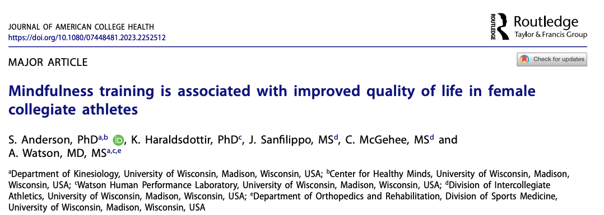


Research: University of Wisconsin
Dr. Drew Watson
Team Physician & Researcher
UW School of Medicine, Department of Orthopedics and Rehabilitation
Chad McGehee
Director of Meditation Training
Wisconsin Athletics &
Center for Healthy Minds

Slide 20
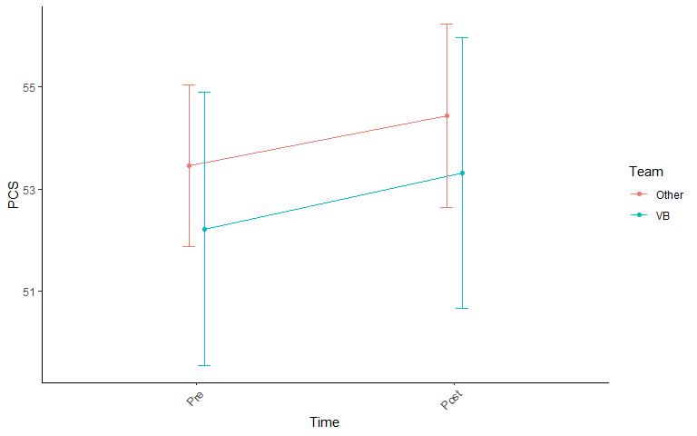
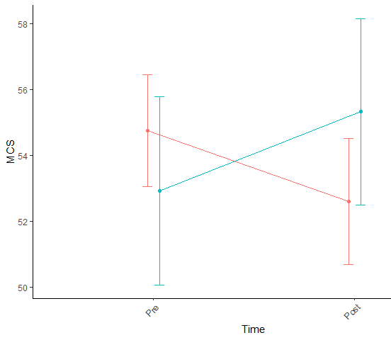
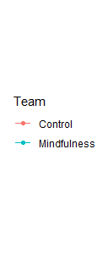
Research: University of Wisconsin
Notes:
This is some of the first research to happen with elite athletes'!!
Foundational Training, benefits show up in mind first

Slide 21

Research: University of Wisconsin
Key Finding #1
On the days when athletes participated in mindfulness training athletes reported significantly better…
Mood
Energy level
Muscle readiness
Readiness to train
Key Finding #2
The day after athletes did a mindfulness practice, the incidence of acute injury decreased by 58%.
Notes:
As we continue the physical benefits really show up

Slide 22
Mental Health Best Practices
Key Components
  Procedures for identification and referral of athletes with mental health/wellness concerns
  Pre-participation mental health screening
    Critical in identifying opportunities to intervene
  Health promoting environments that support mental well-being and coping/resilience
  Information provided via the Interassociation Consensus Document: Mental Health Best Practices; Understanding and Supporting Student-Athlete Mental Wellness
Notes:
Engagement: meetings, conference events, expected attendance

Slide 23
Mental Health Best Practices
Identification and Referral
Written institutional procedures for:
  Management of emergency mental health situations
  Routine mental health referrals
Mental Health Emergency Action and Management Plan
  Information provided via the Interassociation Consensus Document: Mental Health Best Practices; Understanding and Supporting Student-Athlete Mental Wellness
Notes:
Engagement: meetings, conference events, expected attendance

Slide 24
Mental Health Awareness Action Plan
Leadership within school
Student, coach and parent education
Emergent and non-emergent intervention options
Collaborate with healthcare team
  Connect immediately with the needed resources
Mobilize the students support system
Follow-up with referrals
Notes:
Engagement: meetings, conference events, expected attendance

Slide 25
Importance of Education and Training
Why is this important for EVERYONE in your organization
Medical staff can not act alone (if present)
Medical staff can not be everywhere
Coaches, administrators are often in large groups of people
  Events
  Camps
  Youth sports
Notes:
Engagement: meetings, conference events, expected attendance

Slide 26

Immediate Referral
Emergency mental health-related situations:
Suicidal and/or homicidal ideation
Victims of sexual assault
Highly agitated or threatening behavior, acute psychosis or paranoia
Acute delirium/confused state
Acute intoxication or drug overdose
Notes:
Engagement: meetings, conference events, expected attendance

Slide 27

Crisis Management: Non-Life Threatening
How do you determine if a mental health situation is non-life-threatening?
Education
Training
Communication
EVERY SITUATION IS DIFFERENT!
Notes:
Engagement: meetings, conference events, expected attendance

Slide 28

QPR Training/Mental Health First Aid
Training to equip personnel on how to recognize a mental health emergency and get a person at-risk the help they need
MHFA gives trainees the background knowledge and tools to handle a mental health crisis
QPR is a brief course that trains individuals to ask the tough questions surrounding suicide risk and get appropriate help
Notes:
Engagement: meetings, conference events, expected attendance

Slide 29
Epidemic - Not Just Athletes
Administrators/Coaches face increasing pressures from parents at a time when we are seeing younger coaches with less experience get head coaching positions
Parents fuel anxiety in sport
Leads to administrator/coach burnout and increased turnover
Find opportunities to assist in mental wellness
  Virtual healthcare platforms
  Mentoring programs
Notes:
Engagement: meetings, conference events, expected attendance

Slide 30

What can we do?
Create a culture of mental wellness to help reduce the stigma around mental health
Must train/educate coaches, administrators, parents, and athletes to develop this culture
Identify mental health/wellness resources and promote
Have a plan
  Implement, study, adjust, improve
Notes:
Engagement: meetings, conference events, expected attendance

Slide 31

What can we do?
U.S. Council for Athletes’ Health has partnered with Coach Beyond, a coach training and education program developed by LiFEsports at The Ohio State University, to provide a FREE mental health training course to secondary school and youth sport coaches, administrators and parents

Slide 32

What can we do?
The U.S. Council for Athletes’ Health (USCAH) has created a set of four professional development programs aimed specifically at equipping secondary school and youth sport athletic administrators, coaches, and other stakeholders with knowledge to mitigate risk at their school and within their community.
Emergency Preparedness Program
Mental Health and Wellness Program
Diversity, Equity, and Inclusion in Sports Program
Health, Wellness, and Safety for Student-Athletes Program

Slide 33

What can we do?
Create Mental Health Action Plans and have Mental Health Policies and Procedures!
Enhance the structure of athlete mental health/wellness
Consistency and alignment creates successful programming and intervention
Additionally, a mental health emergency action plan (EAP) provides information to ensure response to a mental health emergency is prompt, appropriate, coordinated, and precise
All personnel involved with sports - regardless if they are a healthcare professional – have a professional and ethical responsibility to ensure resources are in place to manage mental health conditions and emergencies
Notes:
Mental wellness and mental health policies and procedures should be developed to enhance the structure of athlete mental wellness, health, and safety as well as the consistency of actions by all parties involved. Additionally, a mental health emergency action plan (EAP) provides information to ensure response to a mental health emergency is prompt, appropriate, coordinated, and precise. All organizations, institutions, and personnel involved with sports - regardless of whether or not they are a healthcare professional - share both a professional and legal responsibility to ensure guidelines are in place to manage mental health conditions and any emergency that could arise.

Slide 34

CONTACT
info@uscah.com | uscah.com

